Slide 1
Data Mapping Approach

Slide 2
Source Systems for Transformation
Source Systems
Assetcenter
OVSD
ESL
Source System Data:
SharePoint – for Assetcenter and OVSD
Report Extract for ESL

Slide 3
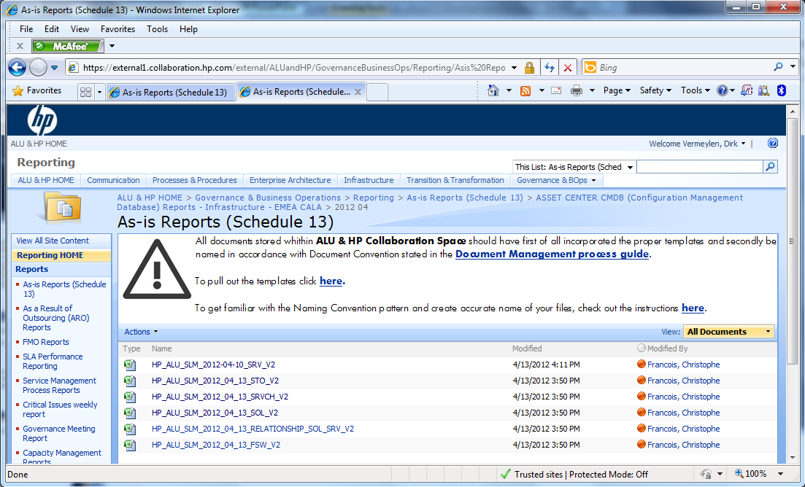
SharePoint location for Assetcenter

Slide 4
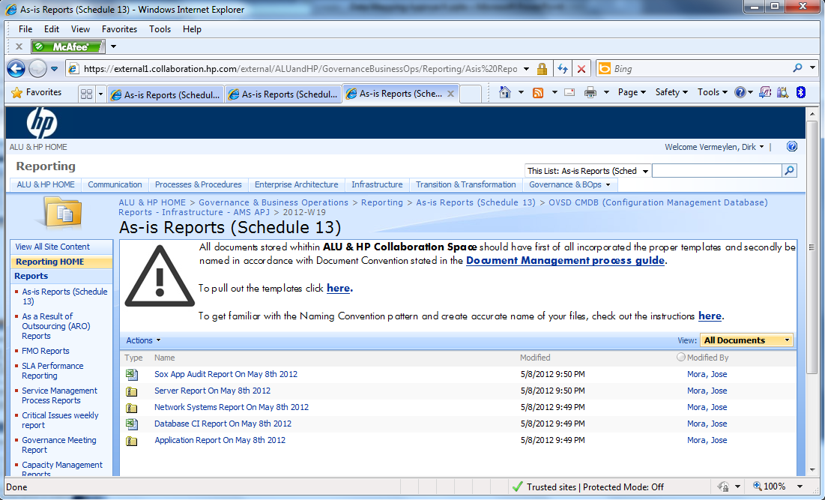
SharePoint location for OVSD

Slide 5
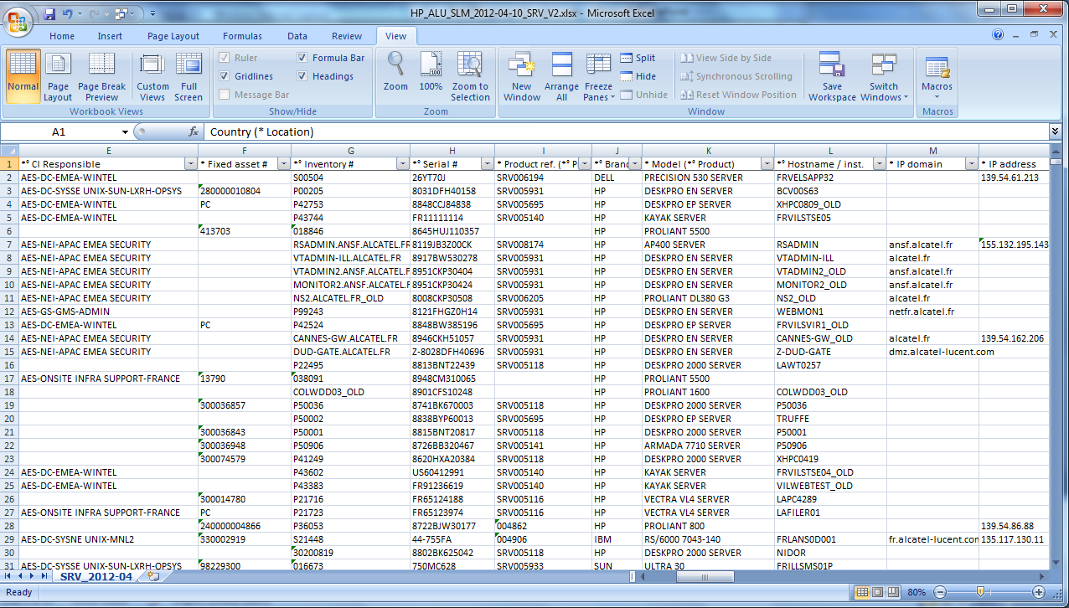
Server Report Example for Assetcenter

Slide 6
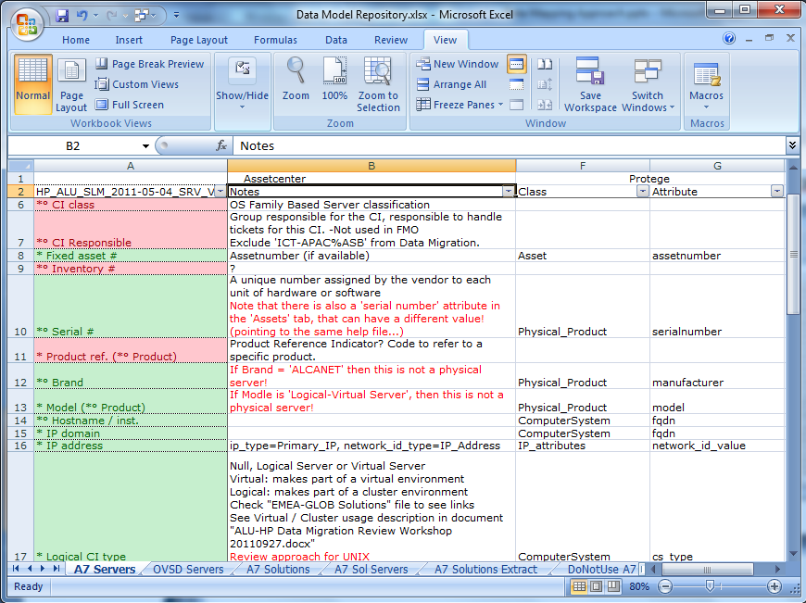
Mapping Example for Assetcenter Server Report
Column Labels
Field Notes & Usage
Sharepoint Report Name

Slide 7
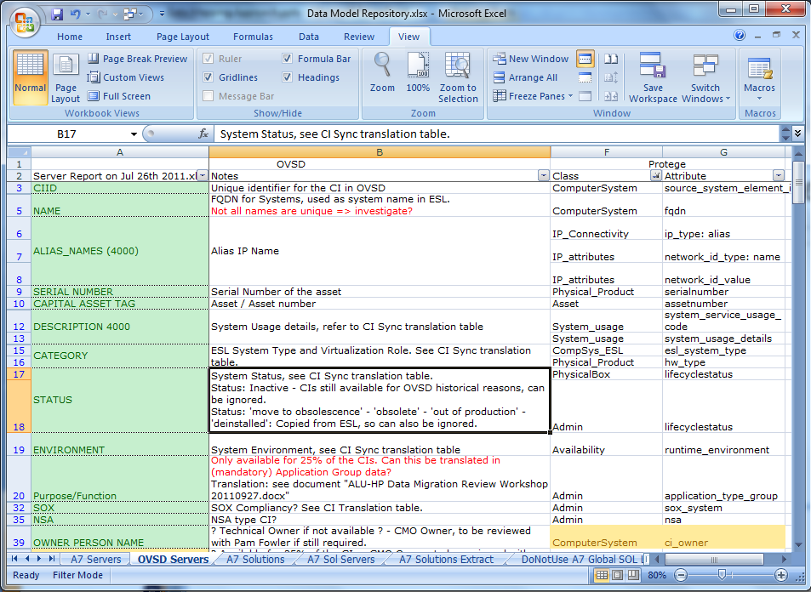
Mapping Example for OVSD Server Report

Slide 8
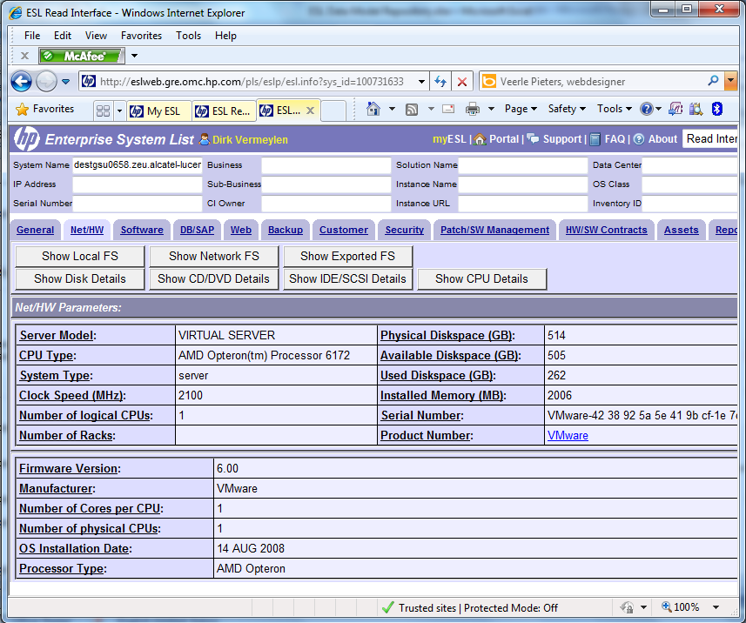
ESL Data Mapping – Based on Tab-Group-Label

Slide 9
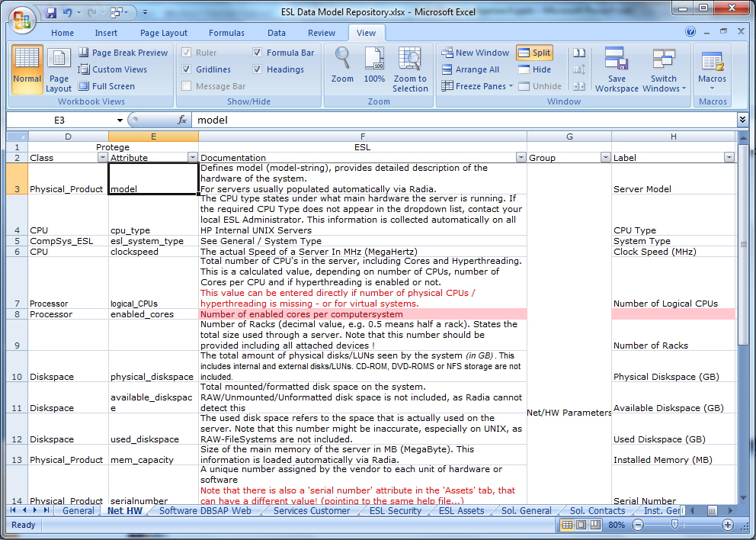
ESL Data Mapping – Based on Tab-Group-Label

Slide 10
Canonical Model to align CMDB Data models
Available from DMTF CIM http://www.dmtf.org/standards/cim
Basis for CMDB implementations
CA CMDB, BMC Atrium, IBM Tivoli, HP uCMDB, ...
CMDB-F
Implemented in Transition Model
Protege Model as ‘Flexible CIM’, interface to Transition Model
Document ‘Protege Data Model Repository.xlsx’
Classes: contains documentation related to Objects
Attributes: contains attribute documentation – consolidated over sources if required.

Slide 11
How to proceed
Please use Report Names and Column labels in your communication
Please align across areas first (SPOC)
Source Fields and Target Fields must be specified for additional data migration requirements
If time allows…
Fields with Protege Class and Attribute are included in Data Migration.
Fields without Protege Class and Attribute are not included in Data Migration

